Slide 1
Chapter 5 – Fixed-Priority Servers
Typical Real-Time systems are hybrids characterized by:
  periodic tasks that execute critical control activities
  aperiodic tasks that are event-driven

Slide 2
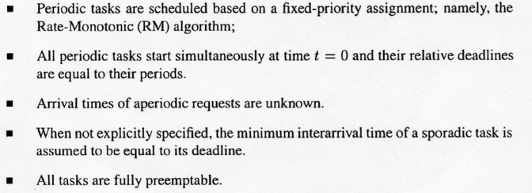
Assumptions for Fixed Priority Servers:

Slide 3
Scheduling Strategies we will explore:
Background Service
First Come First Served (FCFS) service as availability permits
Polling Server (PS)
Pseudo periodic task(s) provides slot for serving aperiodic tasks
Deferrable Server (DS)
Unused capacity is saved for future aperiodic arrivals
Priority Exchange Server (PE)
“Loans” unusable capacity to ready periodic tasks
Sporadic Server
Loans unusable capacity to ready periodic tasks and delays recoup
Slack Stealing
Passive task steals unnecessary slack time in scheduling

Slide 4
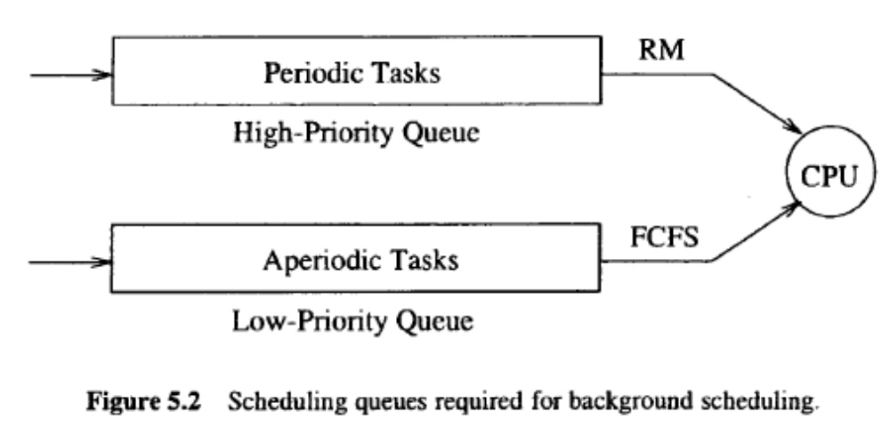
Background Service
Background Service simply queues up aperiodic tasks and services them perhaps on a First Come First Served basis. There are no guarantees.
Advantages: Simple, Can use alternate scheduling algorithm for aperiodic tasks
Disadvantage: No inherent guarantees

Slide 5
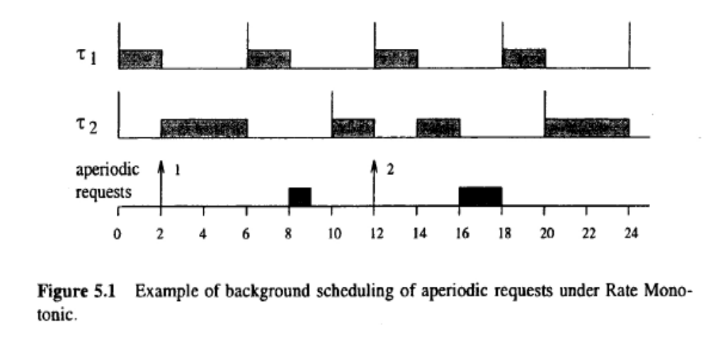
Background Service Example

Slide 6
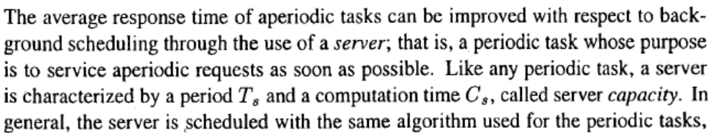

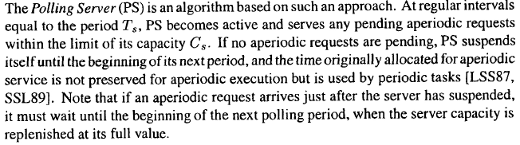
Polling Server
Advantages:
Advantages: Relatively easy to implement
Disadvantages: Not a big advantage in performance

Slide 7
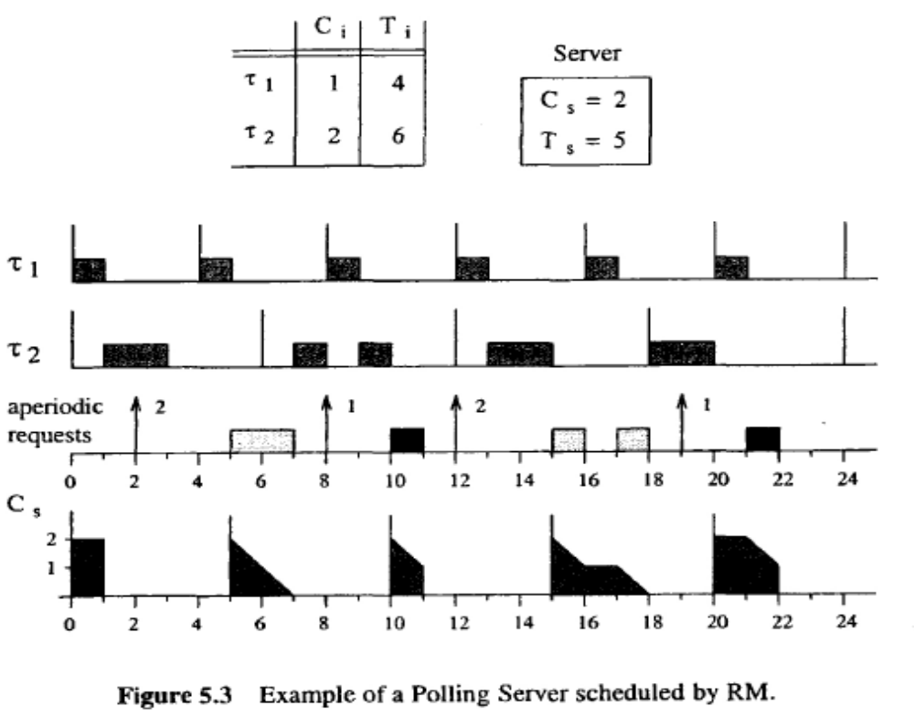
Polling Server Example

Slide 8
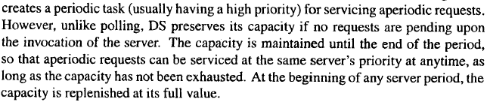
Deferrable Server
Advantages: Much better response time for aperiodic tasks compared to polling
Disadvantages: More complex and DS violates the RM principle that the highest priority task runs when it is ready.

Slide 9
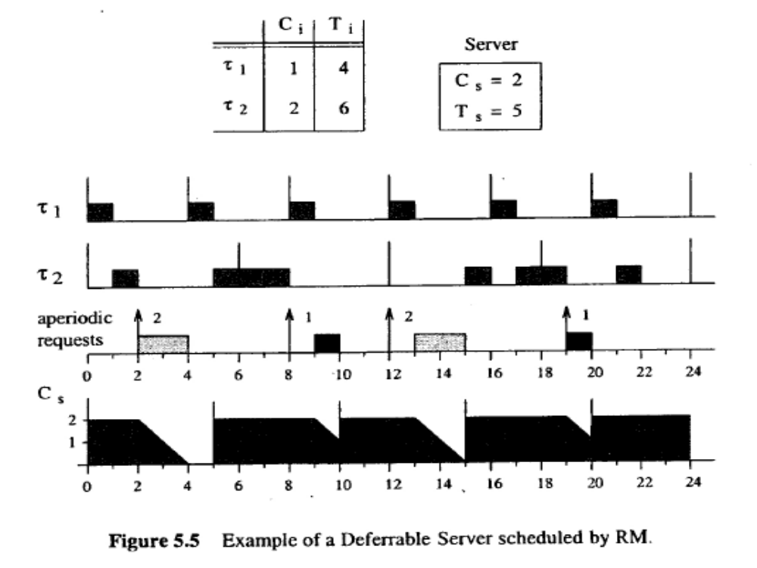
Example of Deferrable Server

Slide 10
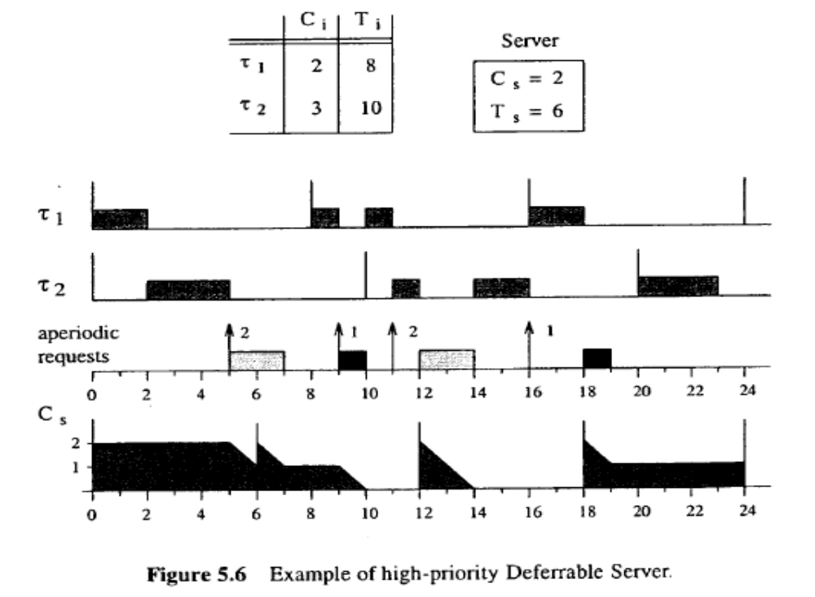
Deferrable Server Example
Shows that Deferrable Server violates the RM task running guarantee

Slide 11
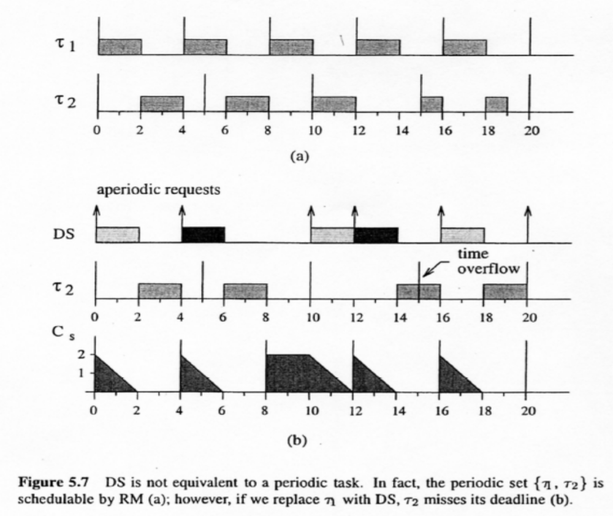
Another Example of Deferrable Server
Shows that the deferring can cause a task deadline to be missed

Slide 12
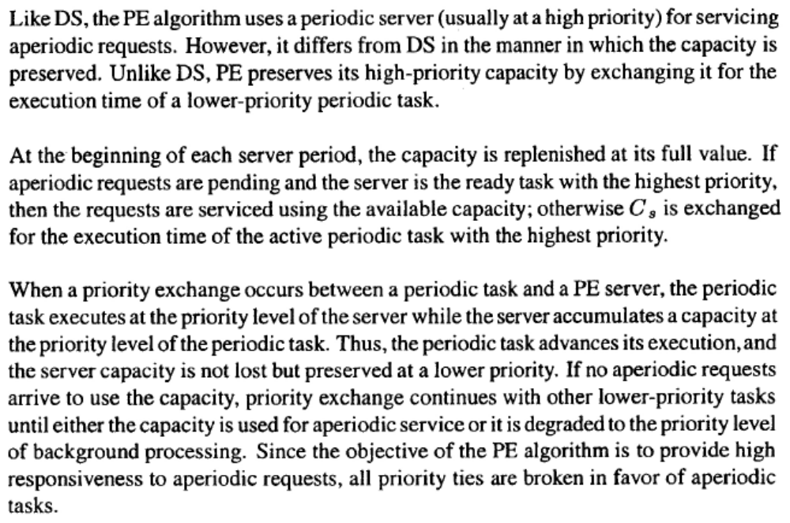
Priority Exchange Server
Advantages: Provides a better Schedulability bound for periodic requests
Disadvantages: Provides worse response for aperiodic tasks compared to Deferrable Server

Slide 13
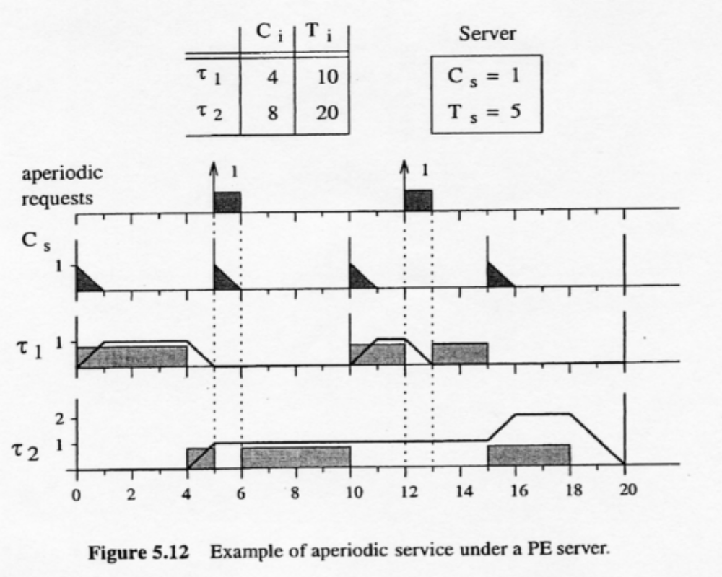
Example of Priority Exchange

Slide 14
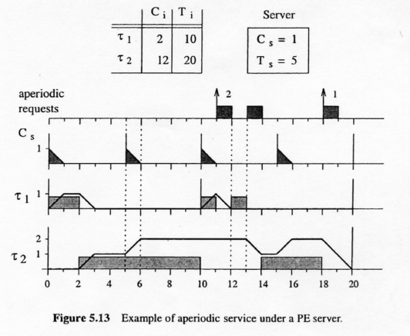
Another Example of Priority Exchange

Slide 15
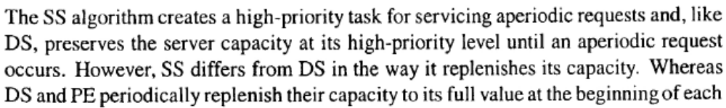
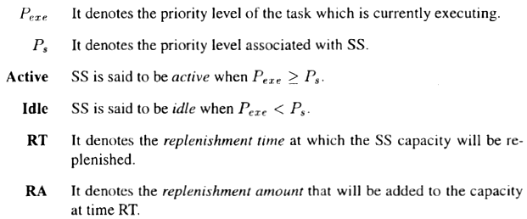
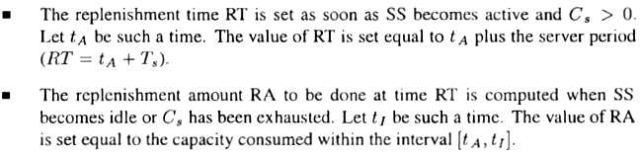
Sporadic Server

Slide 16
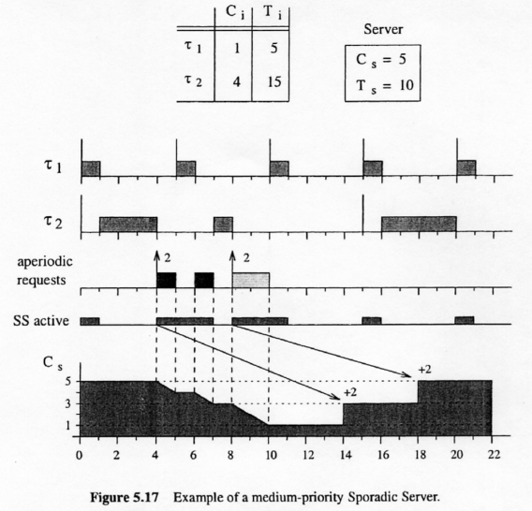
Example of Medium-Priority Sporadic Server

Slide 17
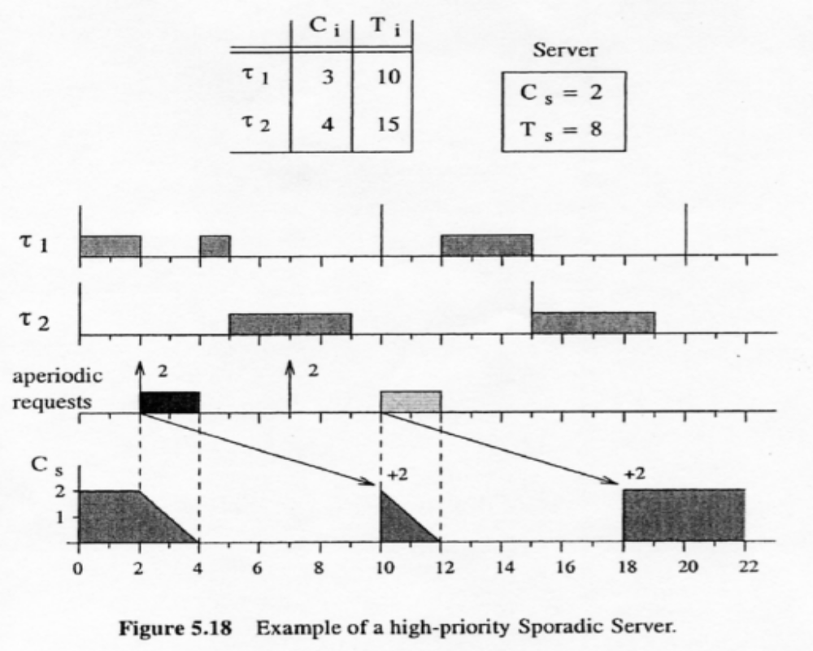
Example of High-Priority Sporadic Server

Slide 18
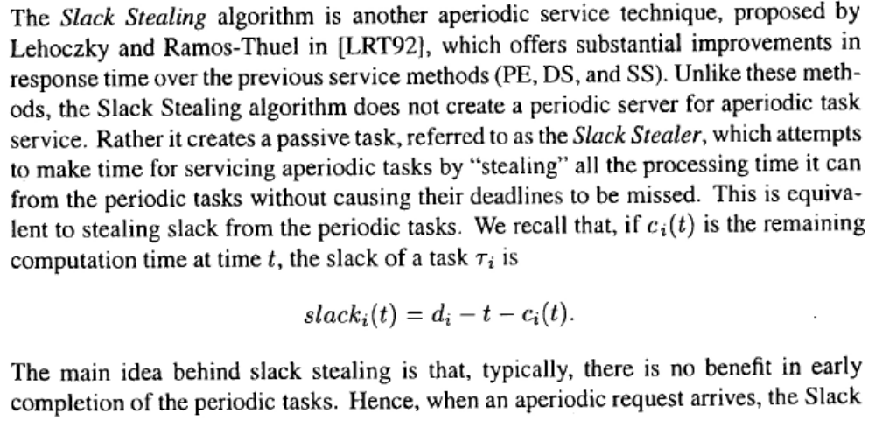
Slack Stealing
Advantages: Substantial improvement in aperiodic task response time
Disadvantages: Complexity

Slide 19
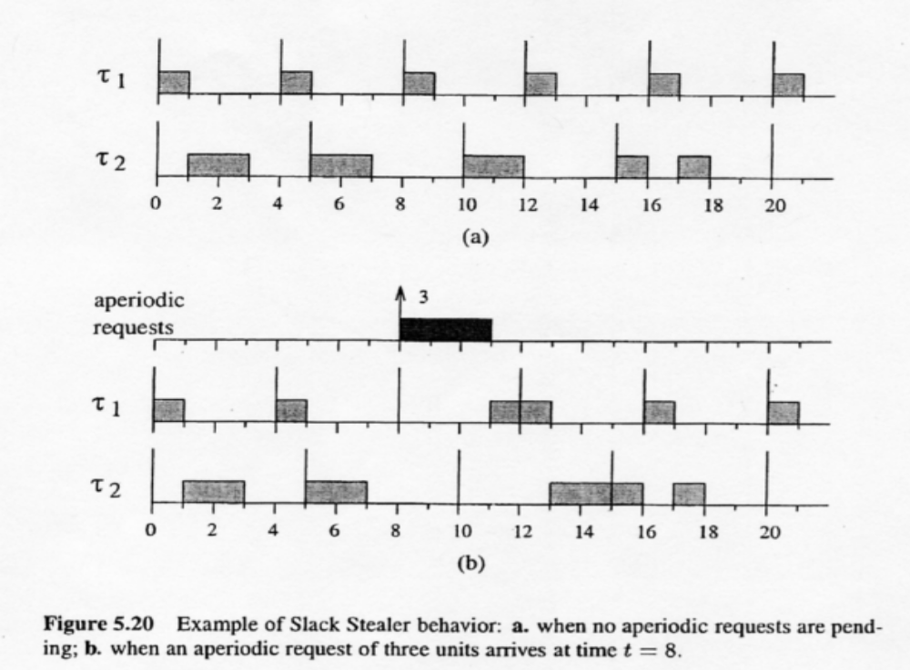
Example of Slack Stealing

Slide 20
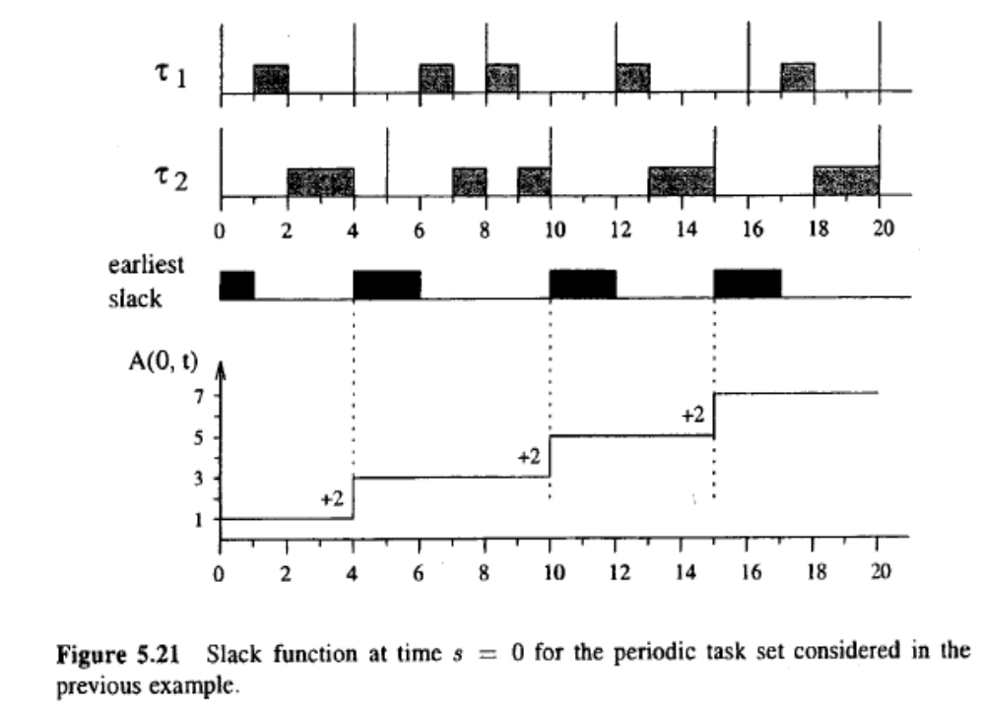
Slack Stealing Example Continued: s=0

Slide 21
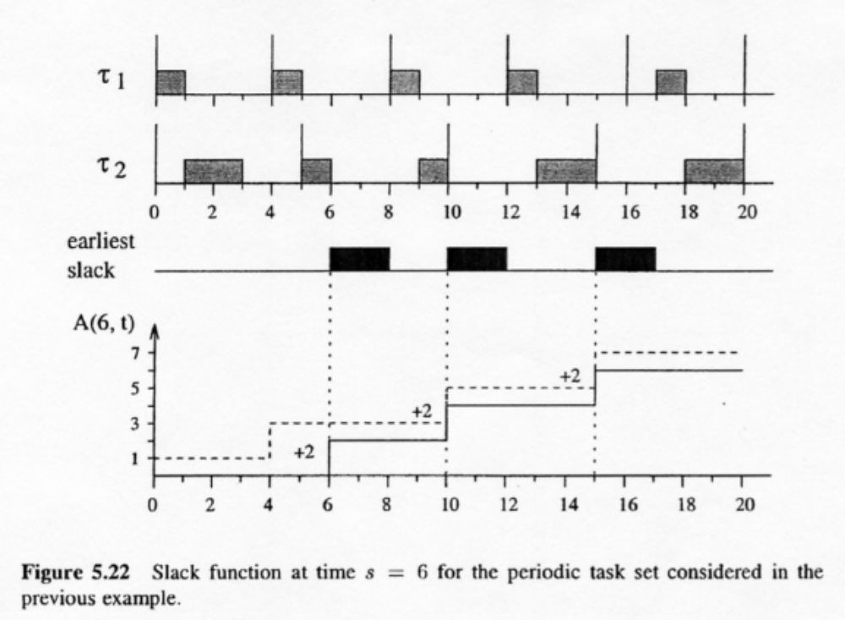
Slack Stealing Example Continued: s=0

Slide 22
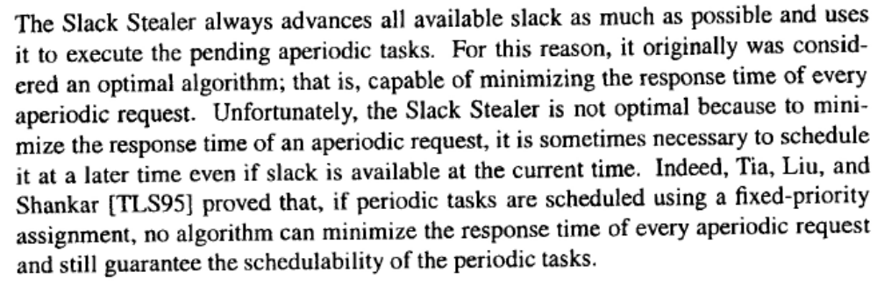
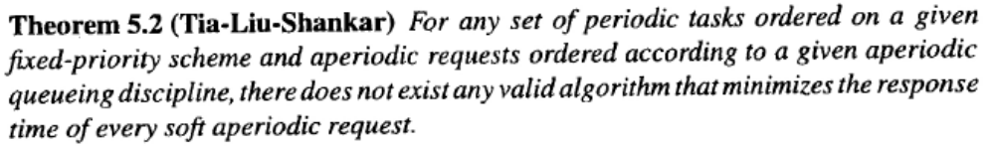
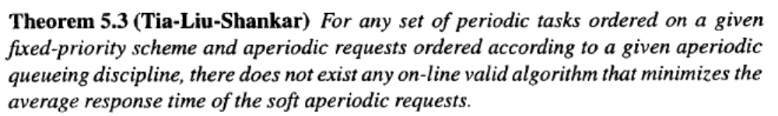
Slack Stealing Does not Lead to an Optimal Schedule

Slide 23
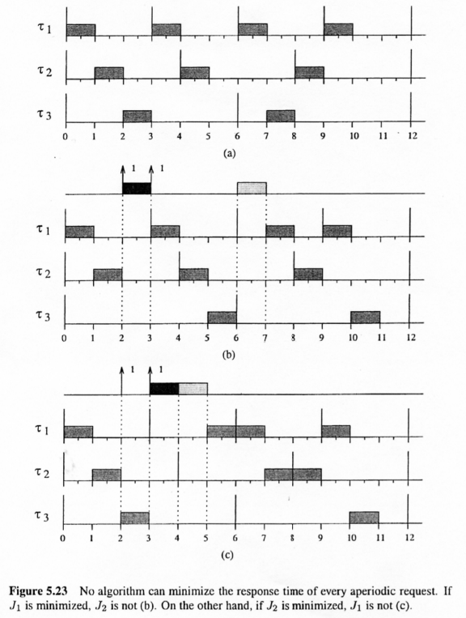
Example to Show Non-existence of Optimal Server

Slide 24
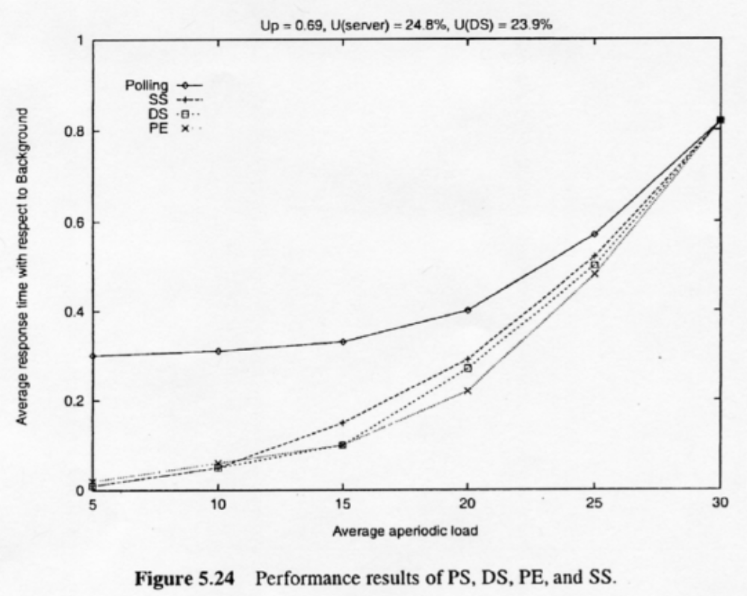
Performance Comparison of PS, DS, PE, & SS

Slide 25
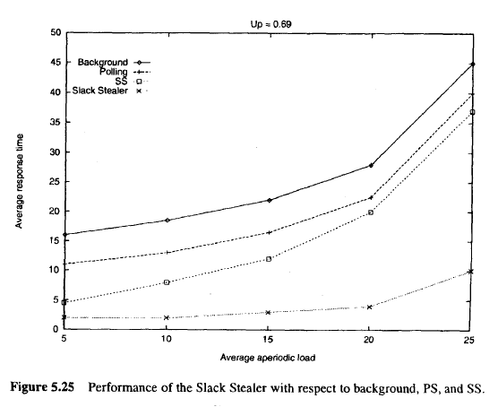
Performance Comparison of Slack Stealer wrt background, PS, & SS

Slide 26
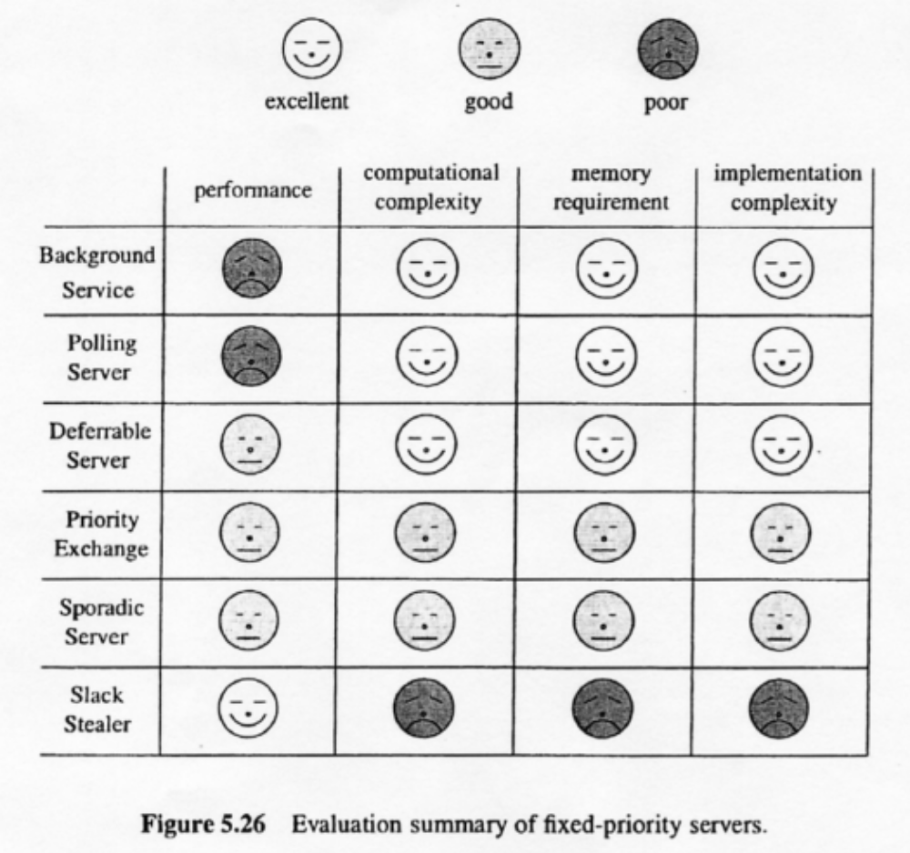
Summary of Fixed-Priority Strategies

